Slide 1


Tess Sweeney
7/16/2023

Slide 2

Outline
Executive Summary
Introduction
Methodology
Results
Conclusion
Appendix

Slide 3
Executive Summary
Summary of methodologies- Space X Data was collected using the SpaceX API and through Web Scraping. The data was then organized and cleaned through data wrangling. After, SQL was used to explore the data, and visualized in python using python and matplotlib. The launch sites were analyzed using folium and ploty dash. Machine learning was then used to predict landing success.
Summary of results: launch site success rates vary, with a trend of increasing success as the flight number rises at each site. Noteworthy variations in success rates exist among different orbits, with certain orbits consistently achieving 100% success while others, such as the SO orbit, exhibit lower success rates.

Slide 4
Introduction
Project background- The price of SpaceX’s Falcon 9 rocket launches is 62 million dollars, which is considerably lower than the prices offered by other companies, reaching as high as 165 million dollars per launch. A significant portion of the cost advantage enjoyed by SpaceX can be attributed to its ability to reuse the first stage of the rocket. Consequently, by assessing the likelihood of a successful first stage landing, one can ascertain the projected cost of a launch. Such information proves valuable in scenarios where a competing company seeks to challenge SpaceX's bid for a rocket launch contract.
Problems you want to find answers- This project will predict if the Falcon 9 stage 1 will land successfully and can be reused.

Slide 5

Section 1

Slide 6
Methodology
Executive Summary
Data collection methodology:
Describe how data was collected
Perform data wrangling
Describe how data was processed
Perform exploratory data analysis (EDA) using visualization and SQL
Perform interactive visual analytics using Folium and Plotly Dash
Perform predictive analysis using classification models
How to build, tune, evaluate classification models

Slide 7
Data Collection
The initial step involved the utilization of the SpaceX API, a RESTful API, to gather the required data. A GET request was made to the SpaceX API, facilitated by a set of auxiliary functions that were specifically designed to extract relevant information from the launch data using identification numbers. Subsequently, the rocket launch data was retrieved from the SpaceX API's URL.
To ensure consistency in the requested JSON results, the SpaceX launch data was obtained through a GET request, followed by the decoding of the response content as a JSON result. The obtained JSON data was then transformed into a Pandas data frame for further analysis and manipulation.
Additionally, web scraping techniques were employed to gather historical launch records of Falcon 9 from a Wikipedia page entitled "List of Falcon 9 and Falcon Heavy launches." The launch records were stored in an HTML format. Using the BeautifulSoup and Request libraries, the Falcon 9 launch HTML table records were extracted from the Wikipedia page, parsed, and subsequently converted into a Pandas data frame.

Slide 8
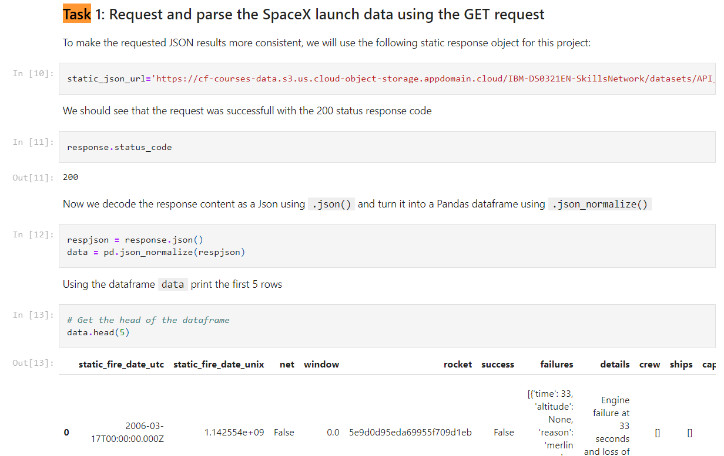
Data Collection – SpaceX API
The process involved collecting data from the SpaceX API through a GET request, parsing the obtained launch data in JSON format, and converting it into a Pandas data frame for further analysis.
https://github.com/tsweenz/IBM-FINAL-COURSE/blob/2faf7fdd61df18cec1fbafbdb717ab097e2153bb/Lab%201%3A%20jupyter-labs-spacex-data-collection-api.ipynb

Slide 9
Data Collection - Scraping
I used web scraping to gather historical launch data of the Falcon 9 rocket from a Wikipedia page. This was achieved by employing BeautifulSoup and requests libraries to extract the launch records from the HTML table on the Wikipedia page. After, I created a data frame by parsing the launch information from the HTML source.
https://github.com/tsweenz/IBM-FINAL-COURSE/blob/a71c09b7e57da885177e8f4d626a532c32c90309/Lab%202%3A%20jupyter-labs-webscraping.ipynb

Slide 10
Data Wrangling
After creating a Pandas DataFrame from the gathered information, I applied filtering based on the 'BoosterVersion' column to retain only Falcon 9 launches. Then, I addressed any missing values in the 'LandingPad' and 'PayloadMass' columns. Specifically, for the 'PayloadMass', I replaced missing values with the mean of the column. Additionally, I conducted Exploratory Data Analysis (EDA) to identify patterns in the data and establish the label for training supervised models
https://github.com/tsweenz/IBM-FINAL-COURSE/blob/a71c09b7e57da885177e8f4d626a532c32c90309/Lab%203%3A%20IBM-DS0321EN-SkillsNetwork_labs_module_1_L3_labs-jupyter-spacex-data_wrangling_jupyterlite.jupyterlite.ipynb

Slide 11
EDA with Data Visualization
Used scatter plots to see the relationship between multiple variables, such as: Flight Number and Orbit Type, Flight Number and Launch Site, Payload and Launch Site, Payload and Orbit Type.
Used Bar Chart to visualize the success rate of each orbit type.
Used Line Plot to visualize the launch success yearly trend.
https://github.com/tsweenz/IBM-FINAL-COURSE/blob/a71c09b7e57da885177e8f4d626a532c32c90309/Lab%205-jupyter-labs-eda-dataviz.ipynb.jupyterlite.ipynb

Slide 12
EDA with SQL
Using bullet point format, summarize the SQL queries you performed:
Displayed the names of the different launch sites:
Displayed 5 rows where the launch sites began with “CCA”
Displayed the total payload weight carried by boosters launched by NASA
Displayed average payload weight carried by booster version F9 v1.1
Found date of first successful landing outcome using ground pad
Found the boosters that are successful in drone ship and also a payload between 4000 and 6000
Found the total number of successful and failed missions.
https://github.com/tsweenz/IBM-FINAL-COURSE/blob/a71c09b7e57da885177e8f4d626a532c32c90309/Lab%204%3A%20jupyter-labs-eda-sql-coursera_sqllite.ipynb

Slide 13
Build an Interactive Map with Folium
I generated a Folium map to pinpoint all the launch sites and utilized various map elements such as markers, circles, and lines to denote the outcome (success or failure) of launches at each site
https://github.com/tsweenz/IBM-FINAL-COURSE/blob/a71c09b7e57da885177e8f4d626a532c32c90309/lab%206_jupyter_launch_site_location.jupyterlite.ipynb

Slide 14
Build a Dashboard with Plotly Dash
I constructed an interactive dashboard application using Plotly Dash, which involved the following steps:
Incorporating a Launch Site Drop-down Input Component
Implementing a callback function to display a success-pie-chart based on the selected site from the dropdown
Introducing a Range Slider for Payload Selection
Implementing a callback function to visualize the success-payload-scatter-chart scatter plot.
https://github.com/tsweenz/IBM-FINAL-COURSE/blob/a71c09b7e57da885177e8f4d626a532c32c90309/Lab%207.%20spacex_dash_app.py

Slide 15
Predictive Analysis (Classification)
After loading the data into a Pandas DataFrame, I conducted exploratory data analysis and determining training labels, using the following steps:
Generating a NumPy array from the 'Class' column in the dataset using the 'to_numpy()' method. This array was then assigned to the variable 'Y' as the target variable.
Then, I standardized the feature dataset (x) by applying the 'preprocessing.StandardScaler()' function from the Scikit-learn library.
Following this, the data was divided into training and testing sets using the 'train_test_split' function from 'sklearn.model_selection'. The 'test_size' parameter was set to 0.2, and 'random_state' was set to 2 for reproducibility.

Slide 16
Predictive Analysis (Classification) Cont.
To identify the most effective machine learning model or method among SVM, Classification Trees, k-nearest neighbors, and Logistic Regression:
Created objects for each algorithm and created a GridSearchCV object, assigning specific parameters for each model.
For each model, I employed GridSearchCV with a cross-validation value of 10, and then fitted the training data to identify the best hyperparameters.
Subsequently, after fitting the training set, found the GridSearchCV object for each model, revealing the best parameters using the 'best_params_' attribute, and the validation accuracy using 'best_score_'.
Finally, I utilized the score method to compute the accuracy on the test data for each model, and visualized a confusion matrix for each, comparing the actual and predicted outcomes.
https://github.com/tsweenz/IBM-FINAL-COURSE/blob/a71c09b7e57da885177e8f4d626a532c32c90309/Lab%208-SpaceX_Machine_Learning_Prediction_Part_5.jupyterlite.ipynb

Slide 17
Results
Exploratory data analysis results
Interactive analytics demo in screenshots
Predictive analysis results

Slide 18

Section 2

Slide 19
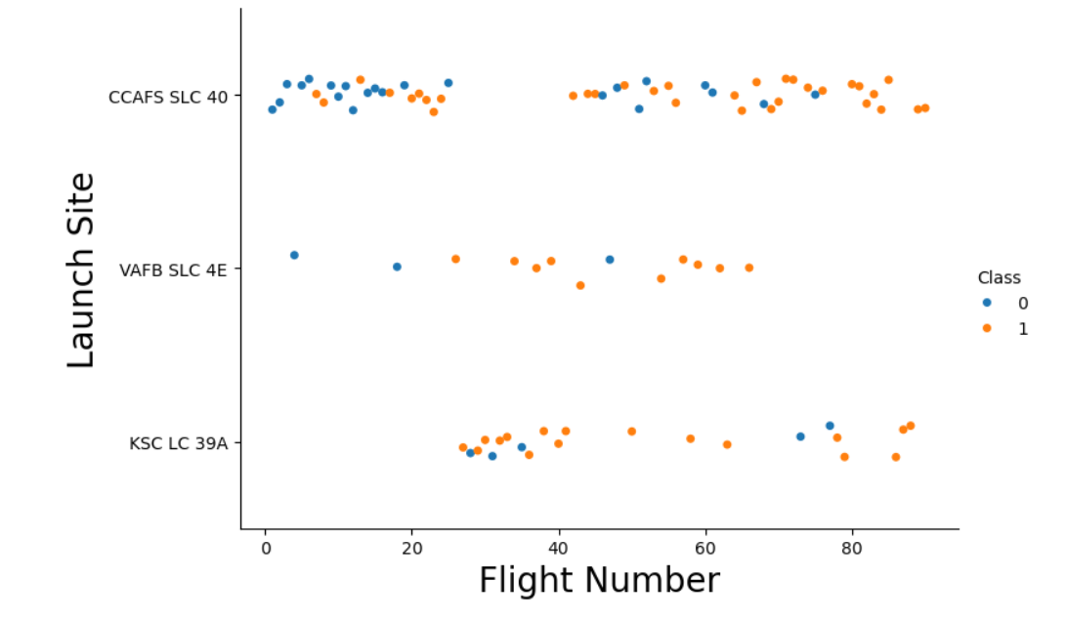
Flight Number vs. Launch Site
As flight number increases, so does the success rate in all three launch sites.

Slide 20
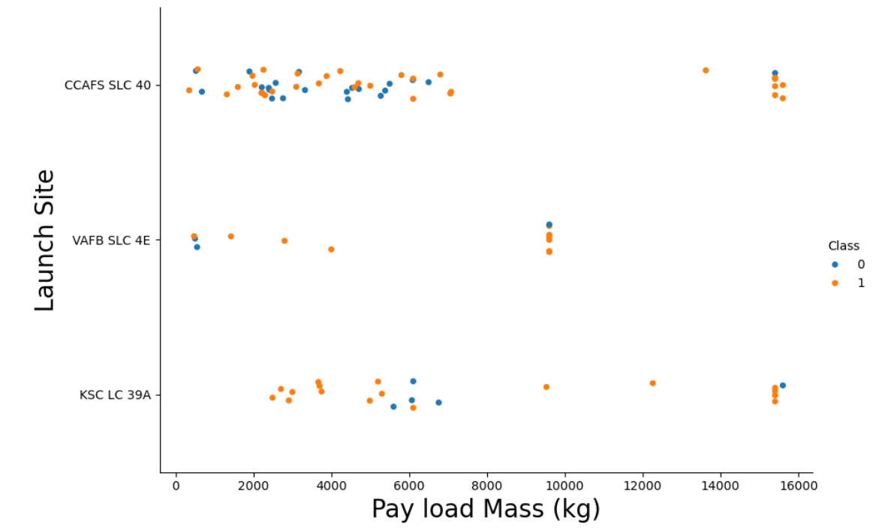
Payload vs. Launch Site
At Launch Site VAFB SLC 4E there are no payloads that are more than 10,000 kg.

Slide 21
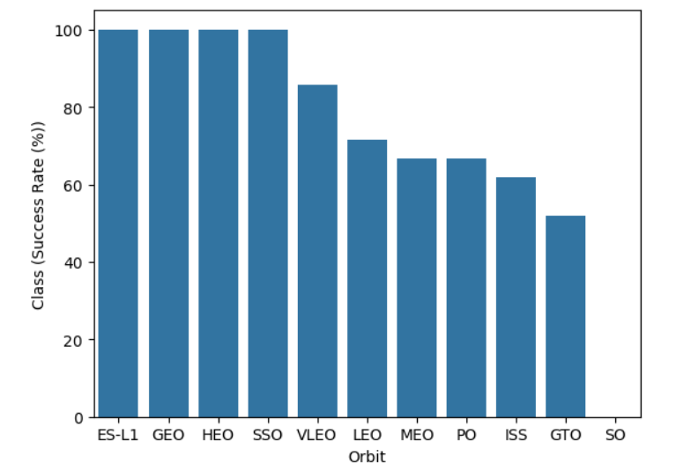
Success Rate vs. Orbit Type
Orbits ES-L1, GEO, HEO, SSO have the highest success rates.

Slide 22
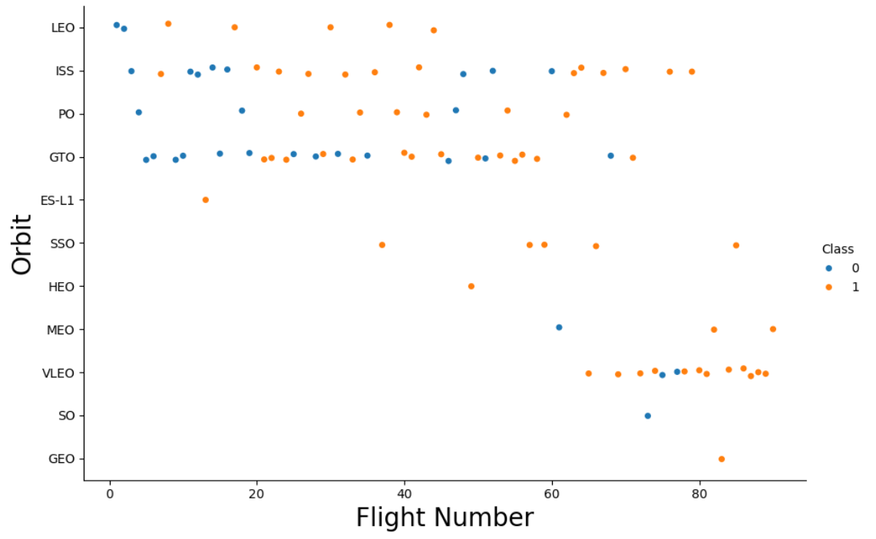
Flight Number vs. Orbit Type
In the LEO orbit success appears to be correlated with the number of flights, whereas in GTO there seems to be no discernible relationship between flight number and success.

Slide 23
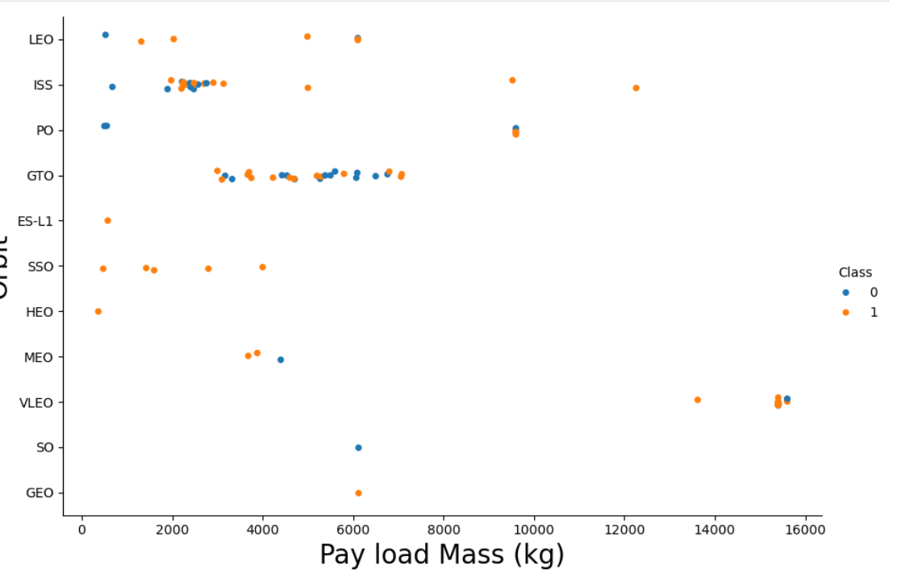
Payload vs. Orbit Type
The VLEO orbit is used for the heaviest payloads. PO and ISS have higher success with heavier payloads compared to lower. GTO’s performance rate remains stable between heavier and lighter payloads.

Slide 24
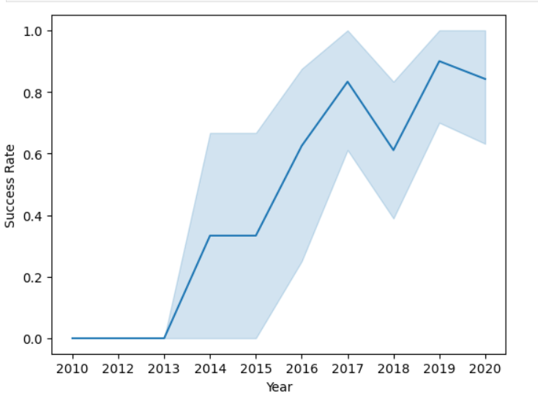
Launch Success Yearly Trend
Launch success has increased throughout the years- with a dip in 2018.

Slide 25
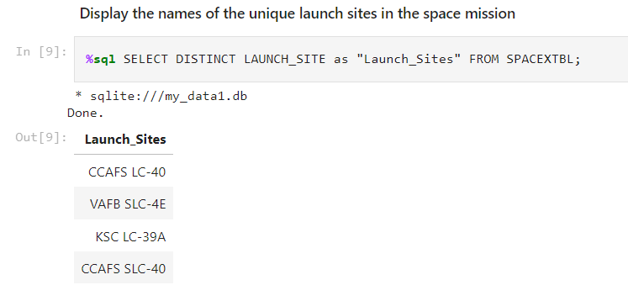
All Launch Site Names
Used SELECT DISTINCT to return the unique launch site names from the table “SPACEXTBL”

Slide 26
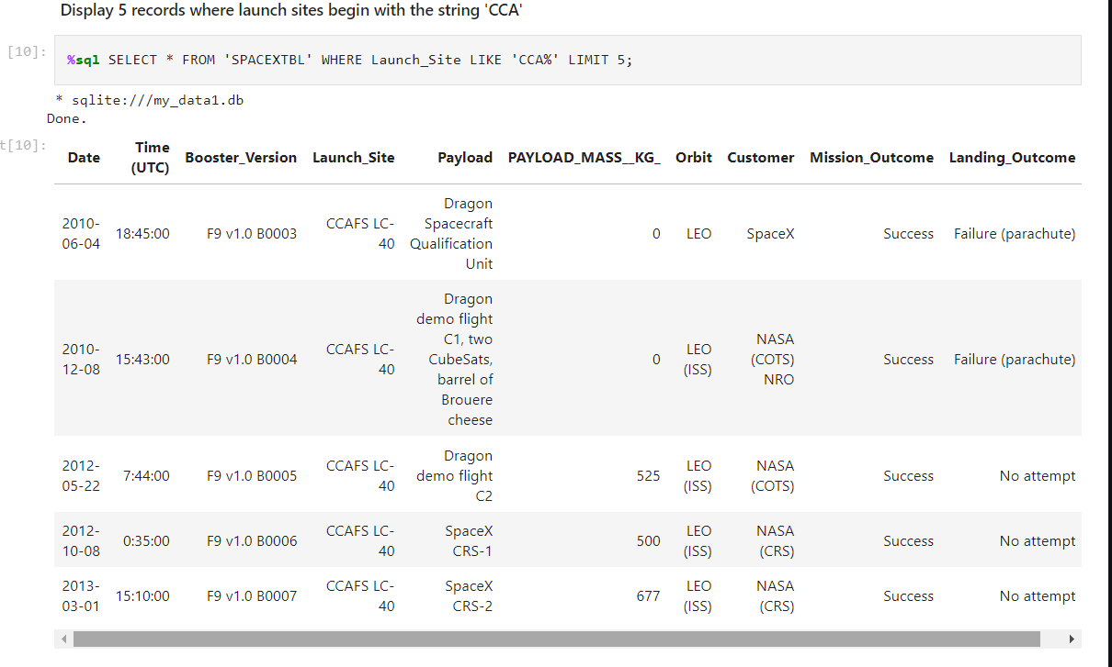
Launch Site Names Begin with 'CCA'
Used “LIKE” to find Launch Sites that started with CCA.
% is used to indicate that zero, one, or multiple characters can follow and be included.

Slide 27
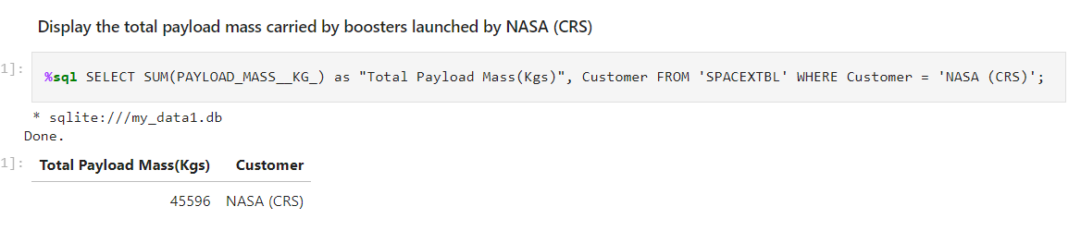
Total Payload Mass
Used SUM to add together the payload mass of all NASA launches
Where Customer = ‘Nasa (CRS)’ is used to take only the sum of payload masses in NASA launches

Slide 28
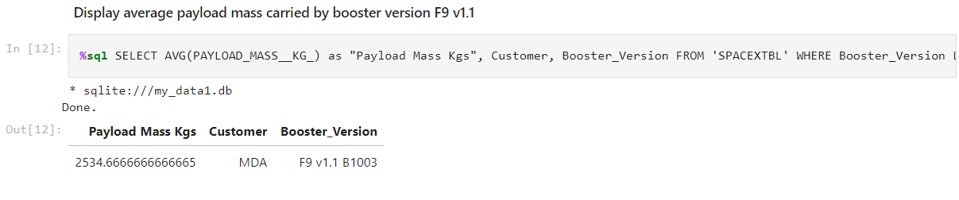
Average Payload Mass by F9 v1.1
Used AVG to return the average payload mass, used WHERE to include only booster version F9 v1.1 in the average.

Slide 29
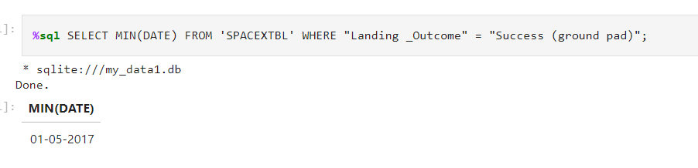
First Successful Ground Landing Date
Found the earliest date of a successful ground landing by using the “MIN” function and limiting the outcomes to Successful Ground Landing by using “WHERE” function.

Slide 30
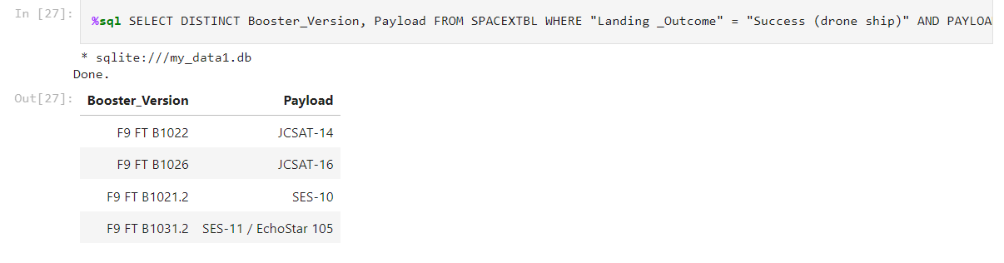
Successful Drone Ship Landing with Payload between 4000 and 6000
Used SELECT DISTINCT to list Booster Versions and limited the result to successful drone ship landing through the WHERE clause.
Used AND to include payload masses between 4000 and 6000.

Slide 31
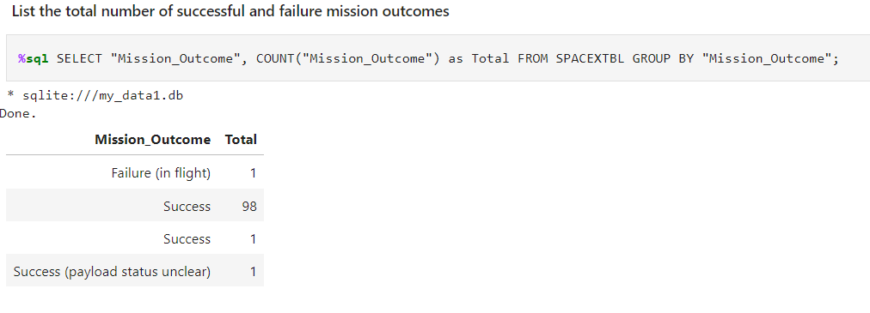
Total Number of Successful and Failure Mission Outcomes
Used 'COUNT()’ and 'GROUP BY' statement to retrieve the overall count of successes and failures.

Slide 32
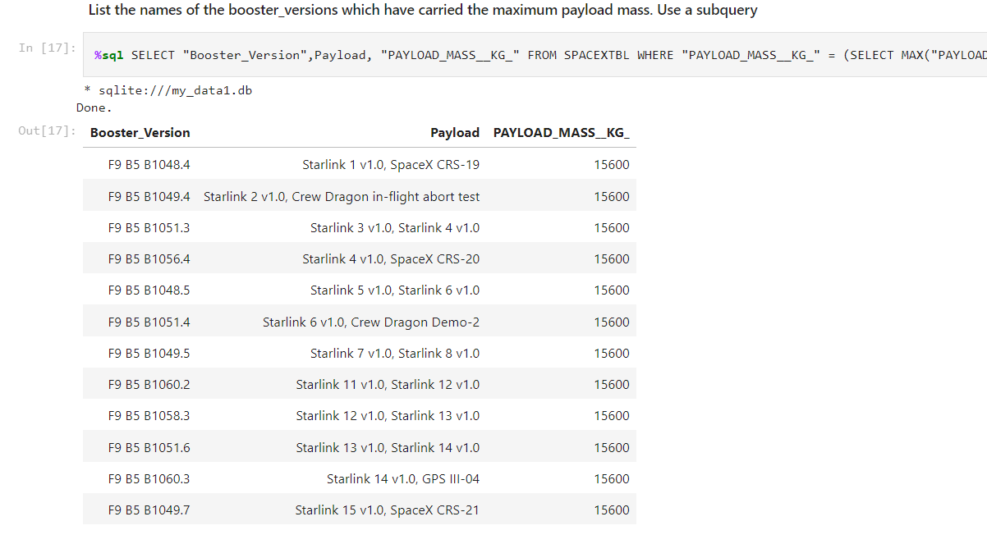
Boosters Carried Maximum Payload
Used MAX to find the maximum payload, and returned the boosters that had carried the max payload

Slide 33
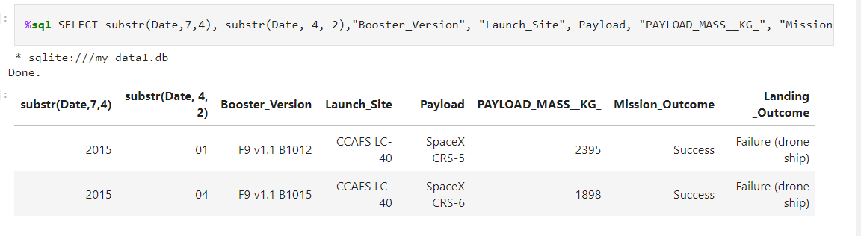
2015 Launch Records
List the failed landing_outcomes in drone ship, their booster versions, and launch site names for in year 2015
Returned failed landing outcomes by using the where clause, limiting it to Failure (drone ship) and limited the year it to 2015 through substr(Date,7,4)='2015'

Slide 34
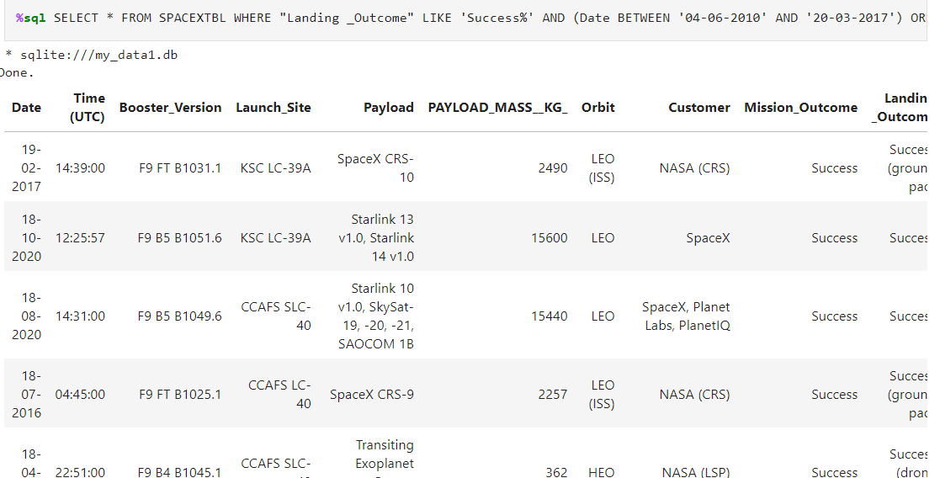
Rank Landing Outcomes Between 2010-06-04 and 2017-03-20
Used BETWEEN to specify date, and DESC to have it listed in descended order based on date ORDER BY Date Desc.

Slide 35

Section 3

Slide 36
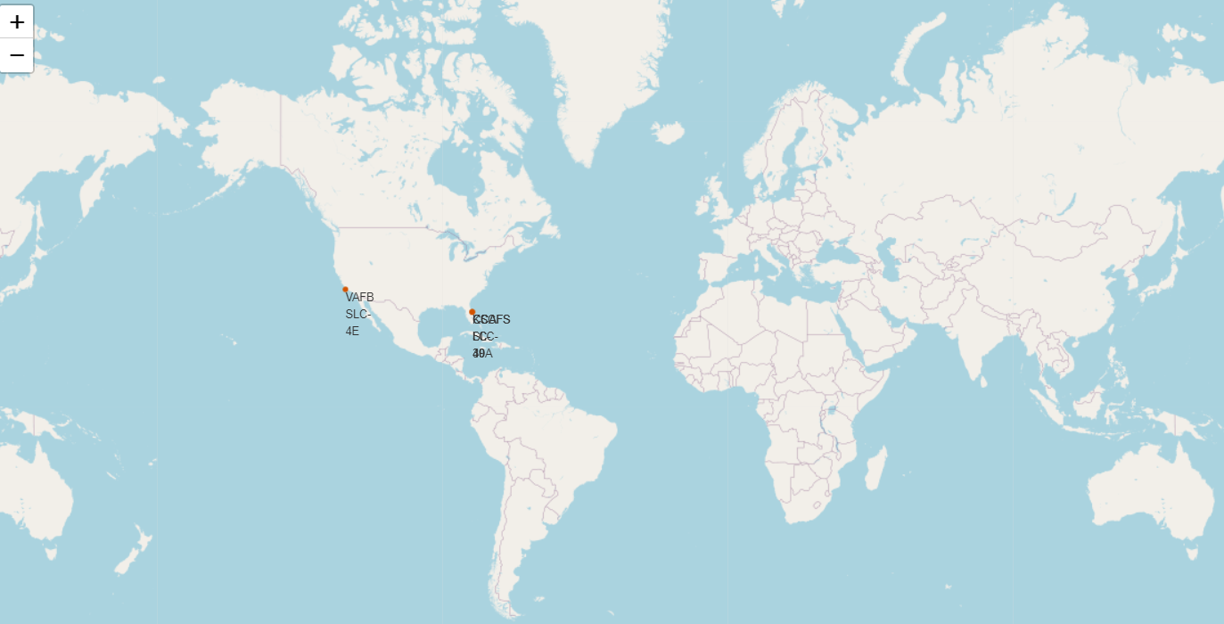
All Launch Sites
All launch sites are in the United States, close to the coast, and in the southern parts of the USA.

Slide 37
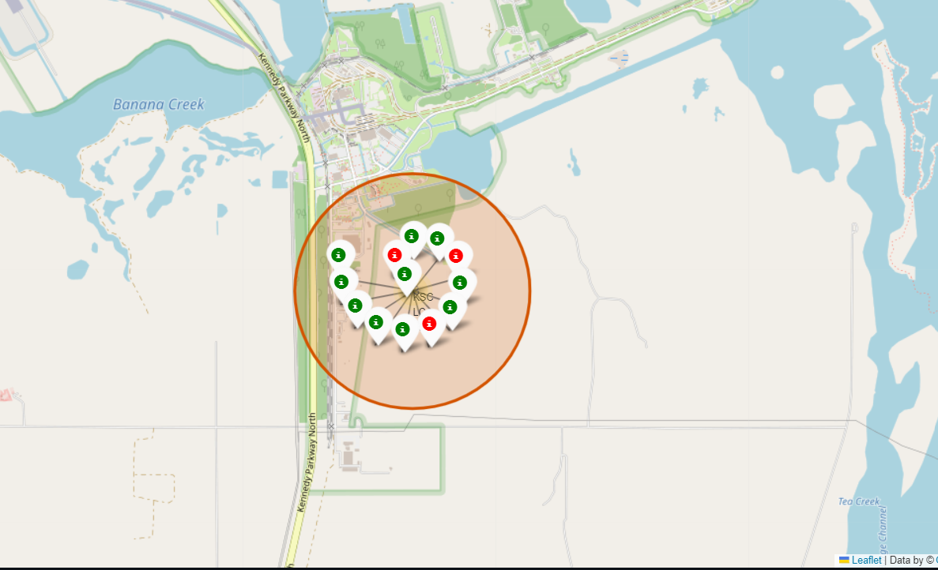
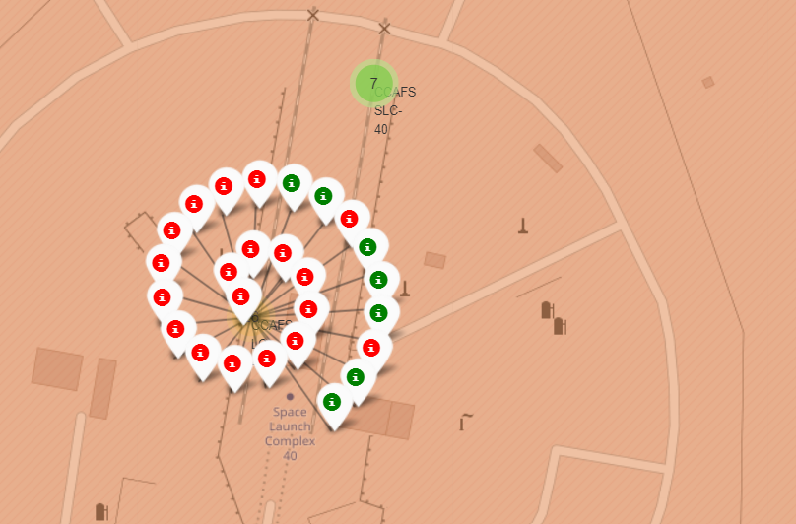
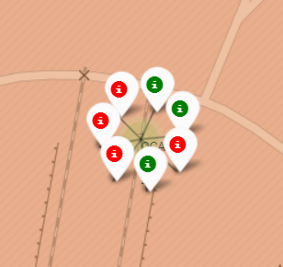
Florida Launch Sites
Site KSC LC-39A has the highest success rates in Florida.
KSC
CCAFS LC-40

Slide 38
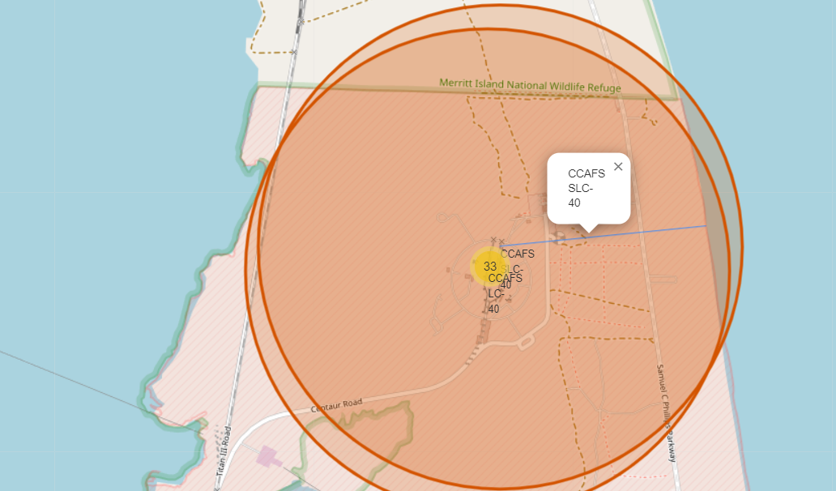
Distance to the Coastline
CCAFS SLC-40 is .90 KM from the coastline.

Slide 39

Section 4

Slide 40
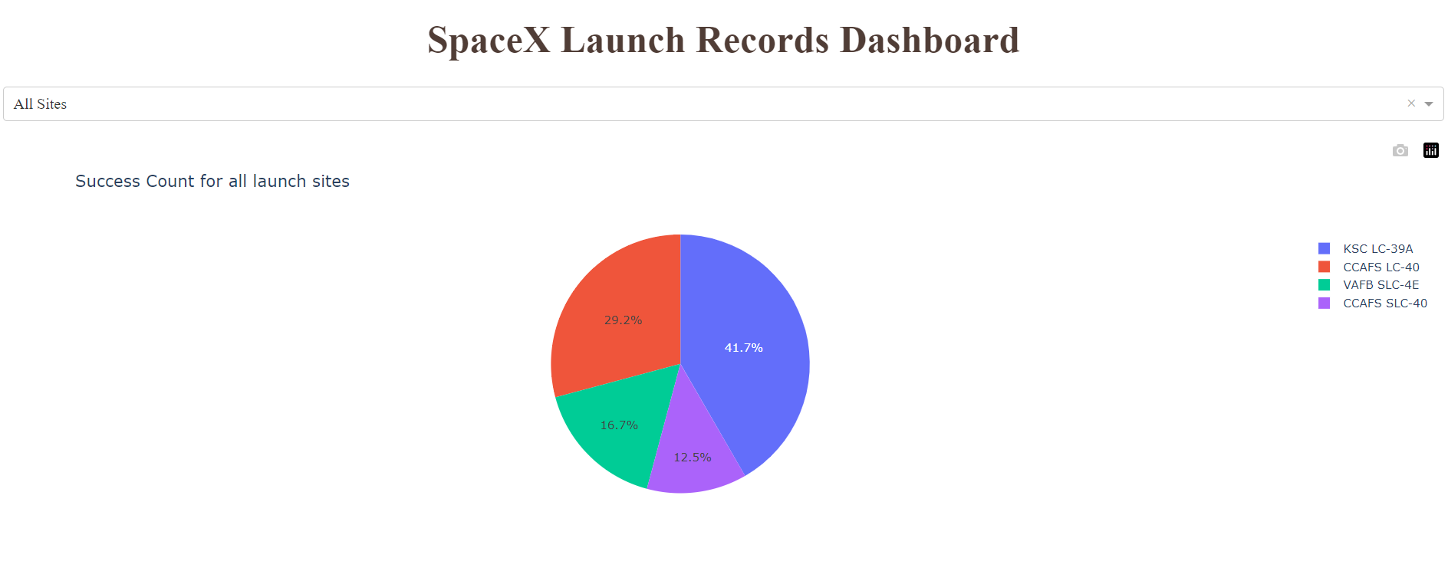
Success Count by Launch Site
KSC had the greatest amount of successful launches, followed by CCAPS, VAFB, and CCAFS.

Slide 41
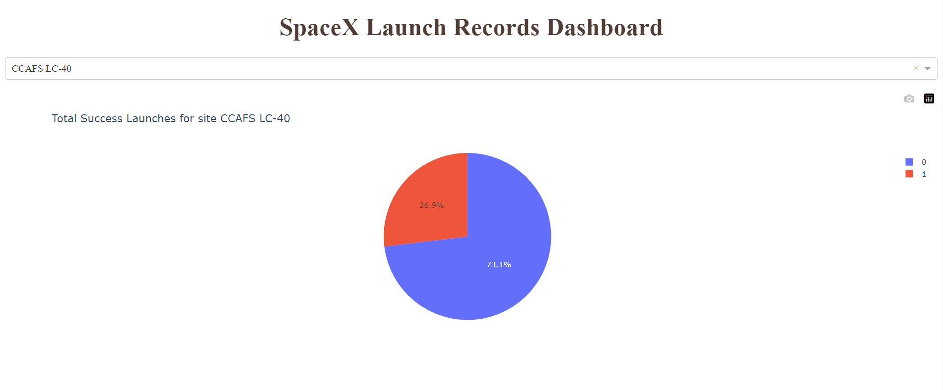
CCAFS LC-40 Success Rate Pie Chart
CCAFS LC-40 had the 2nd highest success rate: 73.1%

Slide 42
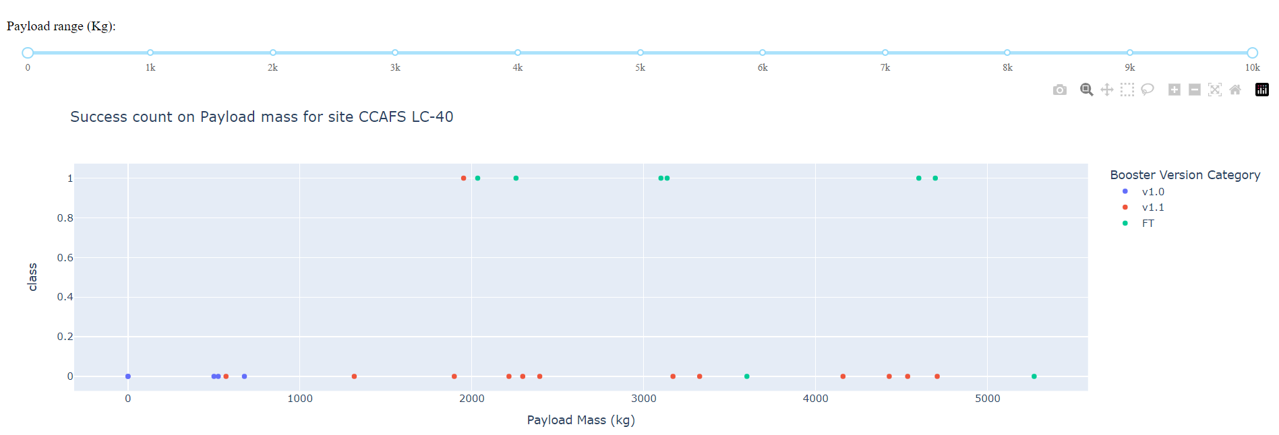
Payload vs. Launch Outcome Scatter Plot
For Launch Site CCAFS LC-40, the v1.1 booster has the highest success rate with heavier payload masses (greater than 2000 kg)

Slide 43

Section 5

Slide 44
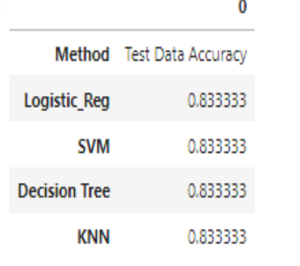
Classification Accuracy
All Classification Models had the same accuracy (.8333…) for the test data.

Slide 45
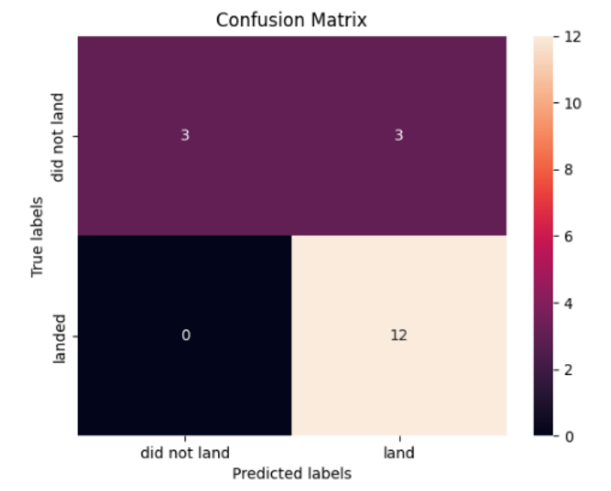
Confusion Matrix
Each of the four classification models exhibited identical confusion matrices and demonstrated an equal ability to differentiate between distinct classes. The primary issue lies in the occurrence of false positives across all models.

Slide 46
Conclusions
Launch site success rates vary. For example, CCAFS LC-40 has a 60% success rate, while KSC LC-39A and VAFB SLC 4E have success rates of 77%.
Notably, as the flight number increases at each launch site, so does the success rate. For instance, the success rate for VAFB SLC 4E reaches 100% after the 50th flight. Similarly, both KSC LC 39A and CCAFS SLC 40 achieve 100% success rates after the 80th flight.
In the Payload Vs. Launch Site scatter plot, no rockets are launched for heavy payloads (greater than 10000) at the VAFB-SLC site.
Orbits ES-L1, GEO, HEO, and SSO consistently attain a 100% success rate, while the SO orbit has the lowest success rate at around 50%, and orbit SO shows a 0% success rate.
In LEO orbit, success appears to be related to the number of flights. However, in GTO orbit, there seems to be no discernible relationship between flight number and success rate.
Regarding heavy payloads, Polar, LEO, and ISS orbits exhibit higher rates of successful landings. However, in the case of GTO, it is challenging to differentiate, as both positive landing rates and negative landings (unsuccessful missions) are observed.

Slide 47


